Slide 1
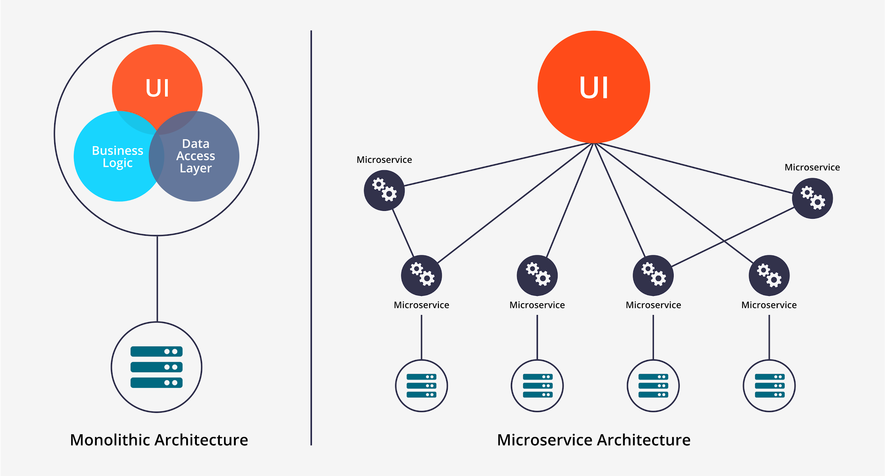
What is Microservice
Microservice architecture split Business Logic and Data Access Layer into several small part called Microservices.
Real business logic and Data access are implemented by invoking multiple different microservices distributed on different nodes.
Notes:
So, what is microservice?
Microservice is a kind of software architecture. To understand it, we need to see the traditional Monolithic Architecture first.
In Monolithic Architecture, usually all things are developed in one application including UI components, Business Logic, and Data Access Layer. And usually that application is deploied on one server node.
However, microservice architecture split Business Logic and Data Access Layer into several small part called Microservices. Real business logic and Data access are implemented by invoking multiple different microservices distributed on different nodes.

Slide 2
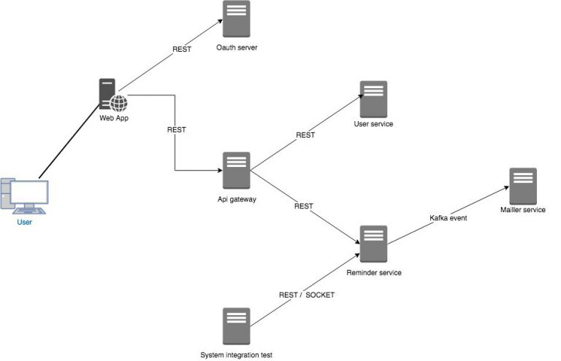
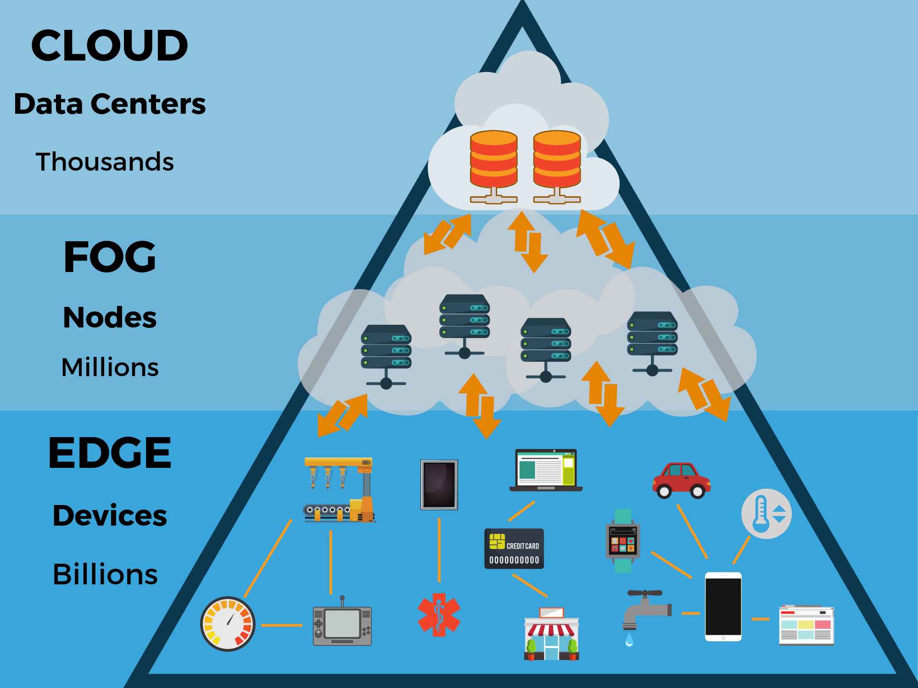
Why should we use Microservice
Scalability —— Distribution
You don’t need to have one very powerful server to run your application. Instead you could use several relatively weaker servers and run different microservices on each of them. The system will have better IO performance since the tasks are distributed and can be done simultaneously.
By combinng microservice with edge computing, you can take advantage of IOT devices like raspberry pi or arduino to provide service locally for users.
Notes:
So, why should we use Microservice?
Comparing to the traditional monolithic architecture, Microservice has much stronger scalability.
First, It really benefit from the distributtion. You don’t need to have one very powerful server to run your application anymore. Instead you could use several relatively weaker servers and run different microservices on each of them.
The system will have better IO performance since the tasks are distributed and can be done simultaneously. And by combinng microservice with edge computing, you can take advantage of IOT devices like raspberry pi or arduino to provide service locally for users.

Slide 3
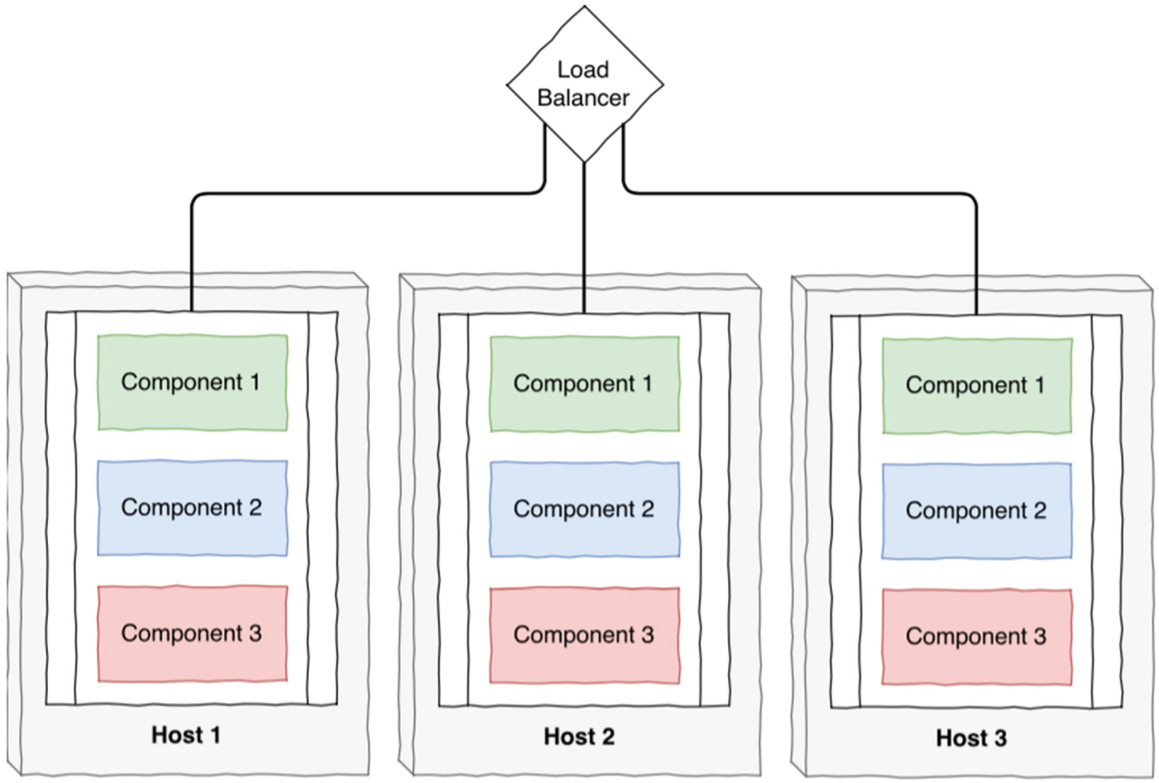
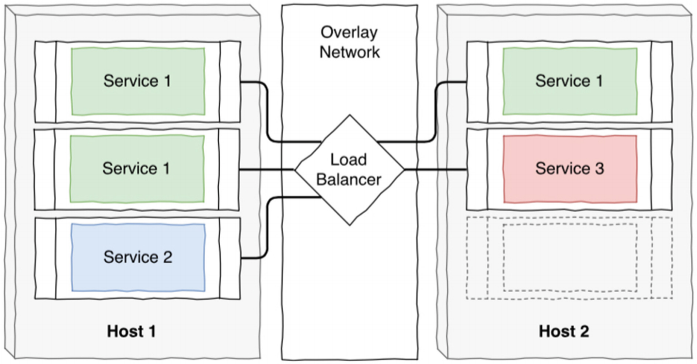
Why should we use Microservice
Scalability —— Non-uniform Scaling
Monolithic Architecture
Microservice Architecture
The bottleneck may only exist in some part of the application like request handling. It makes no sense to replicate the whole application for just improving request handling performance.
In Microservice architecture, we can do non-uniform scaling by deploying multiple instance of particular service so we can get higher utilization with less server resource.
Notes:
Microservice is also good because of its ability of non-uniform scaling.
For traditional monolithic architecture, if we want to scale the application for whatever reason, we have to scale it as a whole application.
But actually the bottleneck may only exist in some part of the application like request handling. It make no sense to replicate the whole application for just improving request handling performance.
In Microservice architecture, we can do non-uniform scaling by deploying multiple instance of particular service so we can get higher utilization with less server resource.

Slide 4

Why should we use Microservice
Scalability —— Portability
Microservice architecture has very good portability by using container technology like Docker
Notes:
So one question here is, how are we going to better utilize all the devices we have to provide services? It would be a nightmare if we need to deploy application using different environments or even on different CPU architecture like ARM.
Luckily, Microservice architecture has very good portability by using container technology like Docker. Docker is an open platform for developing, shipping, and running applications. Docker enables you to separate your applications from your infrastructure so you can deliver software quickly.

Slide 5
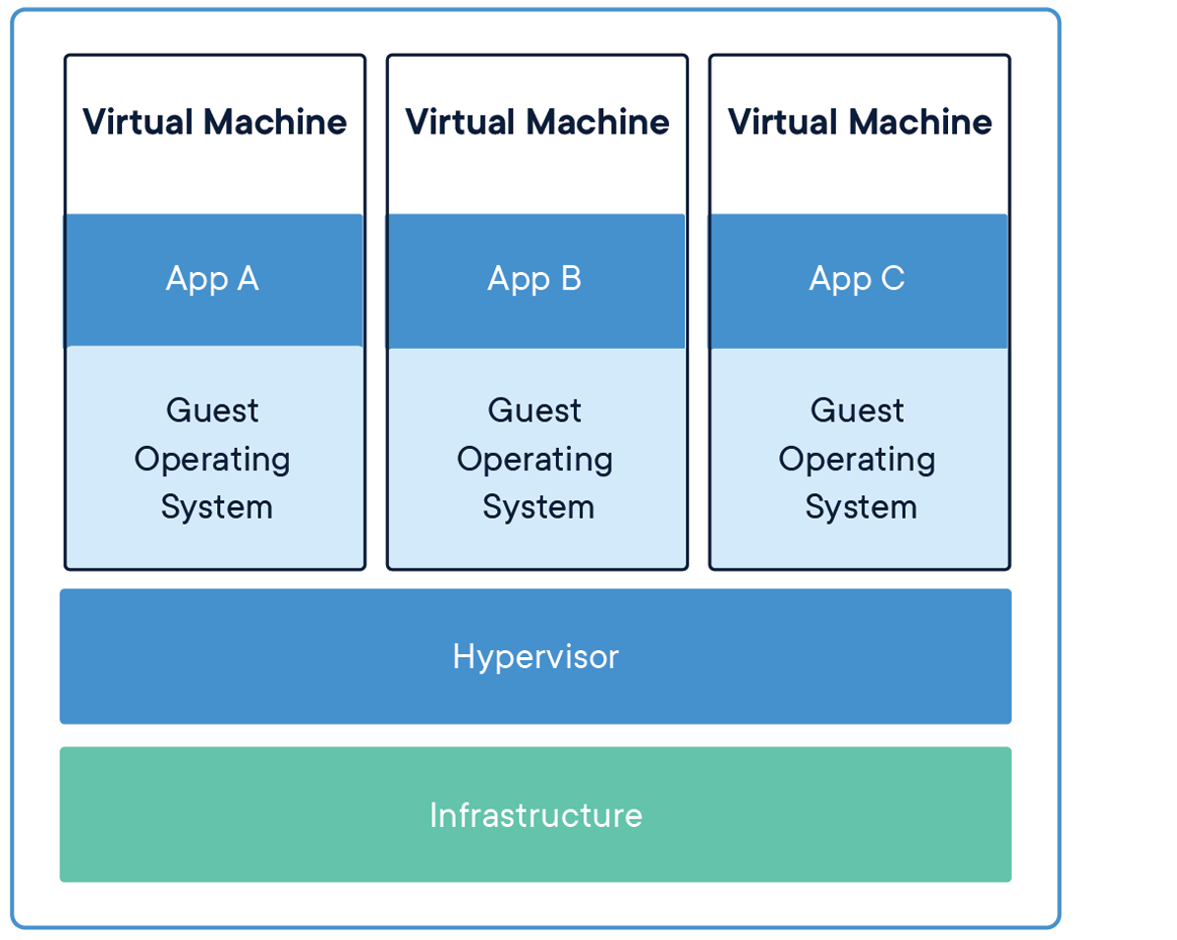
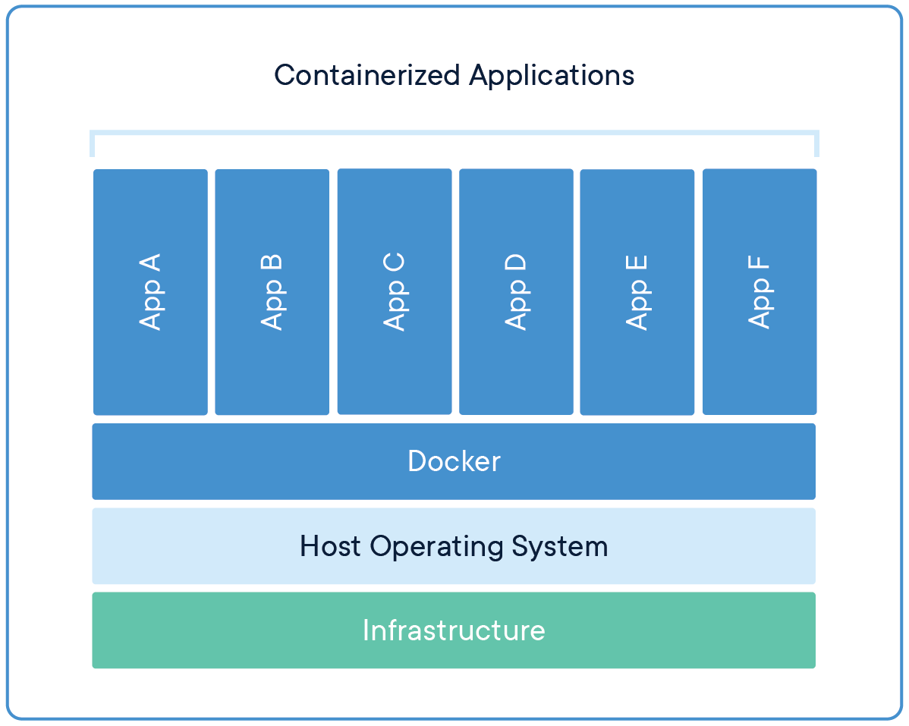
Why should we use Microservice
Scalability —— Portability
Traditional Virtual Machines
Containers
Using Docker doesn’t need to waste resource on duplicated Guest operating system. Docker can also run on ARM devices like raspberry pi which is almost impossible to run virtual machines. By using container technology, microservice can have extremely high utilization of all kind of hardware resources.
Notes:
Comparing to the traditional Virtual Machines way to utilize server resource, container technology doesn’t need to waste resource on duplicated Guest operating system. but it still provide isolated environment for different application, so complex software environment will never be a problem anymore. Besides, Docker can also run on ARM devices like raspberry pi which is almost impossible to run virtual machines.
By using container technology, microservice can have extremely high utilization of all kind of hardware resources.

Slide 6
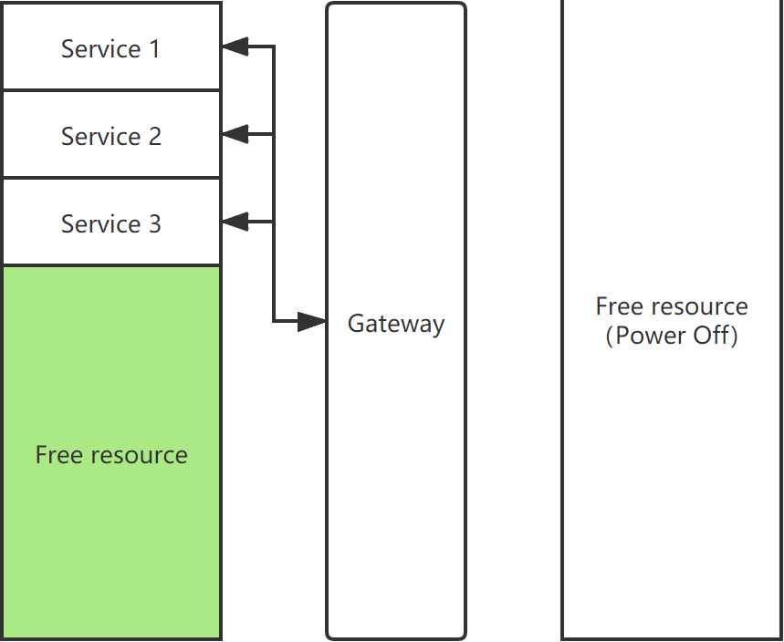
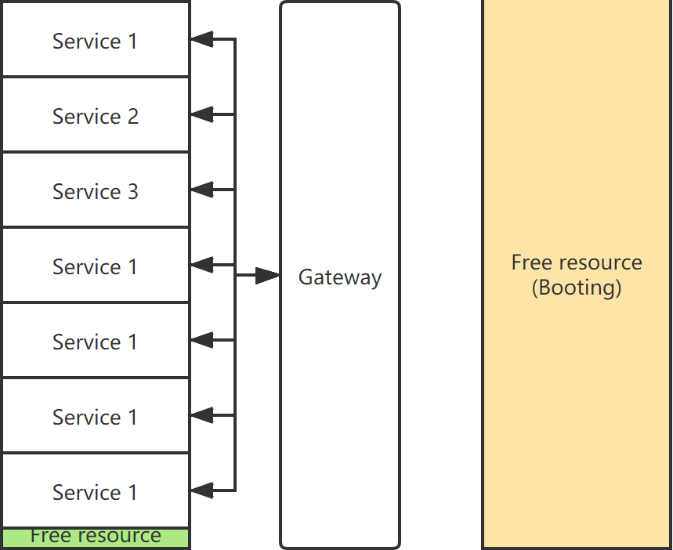
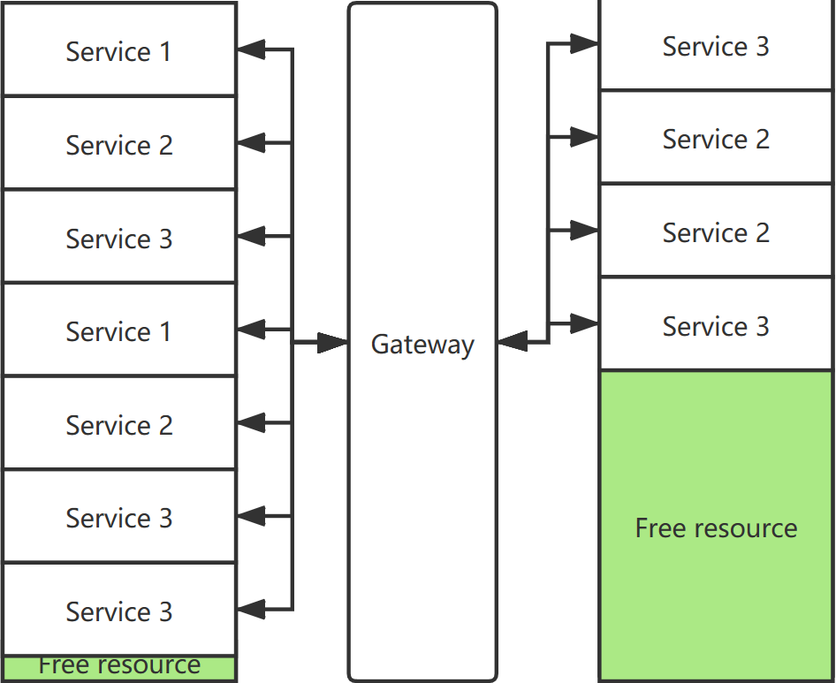
Why should we use Microservice
Scalability —— Elasticity
When there are not so many requests, the server load is low, and it can stop those unnecessary replicas of services and shutting down some servers to save power and reduce the stress of cooling system. When the request increase, the server could automatically deploy new containers to provide service according to the metrics like response time. When the request number increasing speed hit some threshold or if our machine learning model predicted that there will be a heavy load, the system could boot some servers for more resource to deploy microservice. vice versa
Notes:
Another benifit of Microservice is it’s elasticity.
When there are not so many requests, the server load is low and it can stop those unnecessary replicas of services and shutting down some servers to save power and reduce the stress of cooling system.
When the request increase, the server could automatically deploy new containers to provide service according to the metrics like response time.
When the request number increasing speed hit some threshold or if our machine learning model predicted that there will be a heavy load, the system could boot some servers for more resource to deploy microservice.
vice versa
All these scaling can be done automatically, this could help the companies to save a lot of money and help the world to save a lot of power and reduce carbon emission.

Slide 7
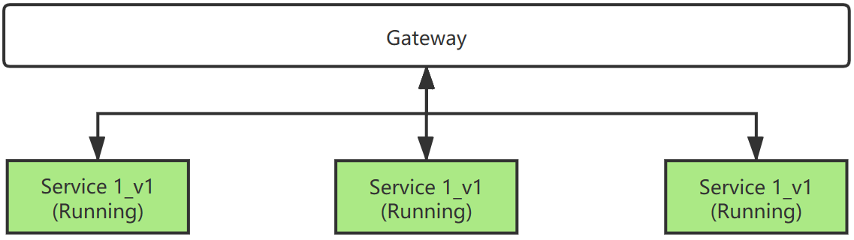
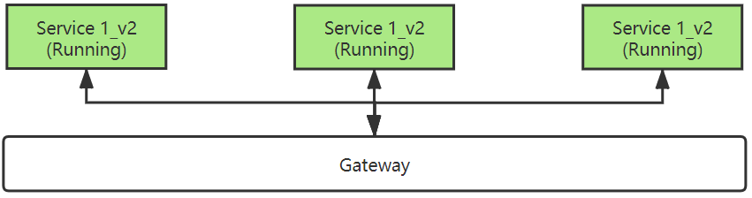
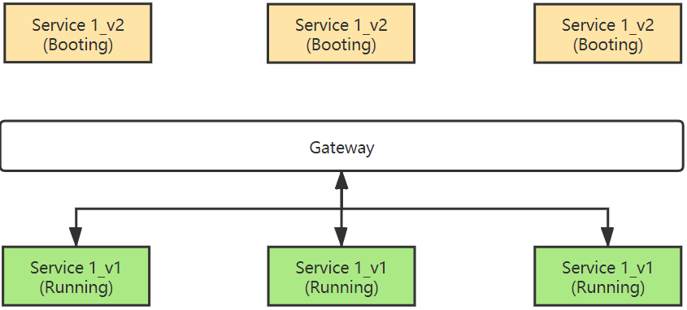
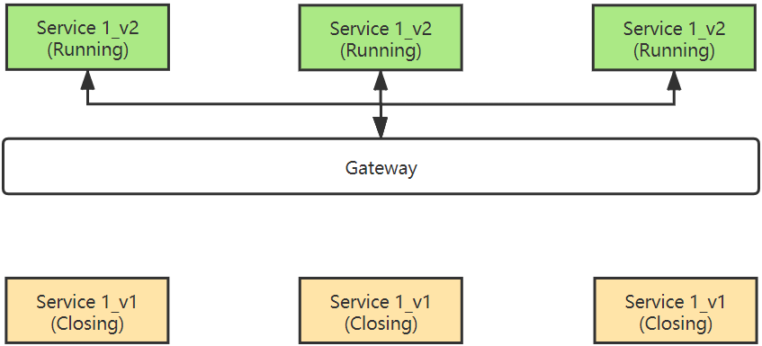
Why should we use Microservice
Scalability —— Availability
When updating the application, we don’t have to shutdown the whole application and then deploy the new one.
by using microservice architecture, we just need a little bit of extra resource for the service we are going to update.
Notes:
Because of the scalability, the microservice architecture usually have high availability.
An common case in software engineering is updating the application.
If we use monolithic architecture, we have to shutdown the whole application and then deploy the new one.
Yes we can use a replica of the application to provide all services during the update but that will need double hardware resources.
However, by using microservice architecture, we just need a little bit of extra resource for the service we are going to update. If there are multiple services need to be updated, we can update them one by one and still we only need a little bit of extra resource.
If we use canary release for updating the service, we can even use zero extra resource.

Slide 8
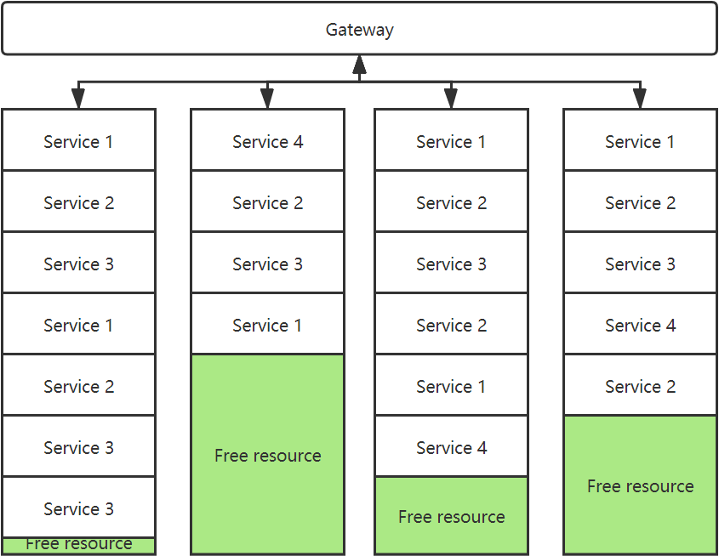
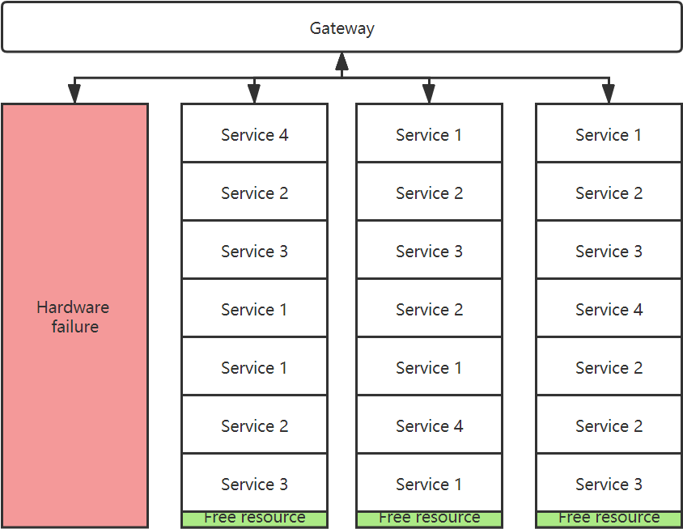
Why should we use Microservice
Scalability —— Robustness
If one server has hardware failure like hardware broken or power cut. other servers could still provide all the services.
Notes:
With all the features I’ve talked about before, the microservice architecture is very robust.
If one server has hardware failure like hardware broken or power cut. other servers could still provide all the services. All the services exist on the failed server could be automatically re-deployed on the rest servers so the total number of service nodes will keep the same and the performance of the whole system will not be affected.

Slide 9
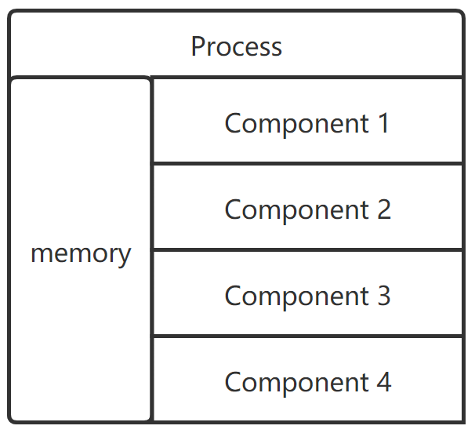
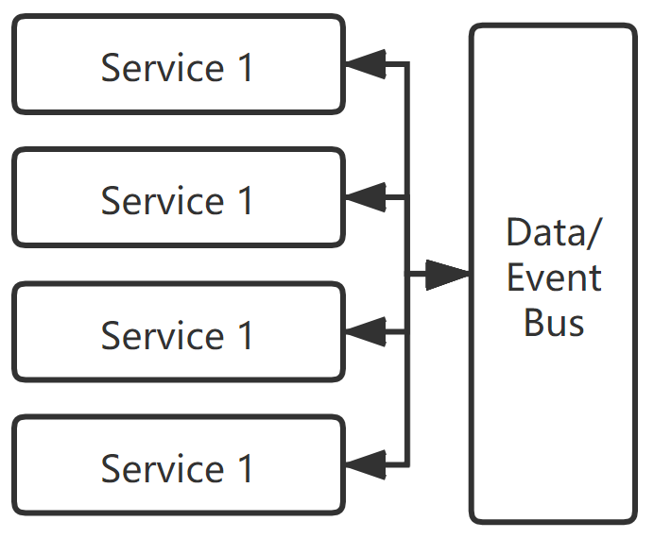
Where should we use Microservice
Do you heavily rely on in-memory state?
monolithic system
microservices system
In monolithic system, you can take advantage of in-memory state like storing session in memory and mapping request according to the session record in almost no-latency using hashmap. But in microservice, because of the distribution, services can not share memory data. All microservice should be designed as stateless functions.
If you heavily rely on in-memory state or can not accept the latency caused by the data sharing in the distributed microservice architecture, you shouldn’t use microservice here.
Notes:
After knowing all these benefit of microservice, we need also know where should we use microservice. In most cases you can always use microservice for the whole system to get a good scalability and performance. But there are two problems you need to be careful with.
First problem we need to consider is: Do you heavily rely on in-memory state?
In monolithic system, you can take advantage of in-memory state like storing session in memory and mapping request according to the session record in almost no-latency using hashmap.
but in microservice, because of the distribution, services can not share memory data. All microservice should be designed as stateless functions. Although different services can share data using middlewares like message queue, there will be some latency.
If you heavily rely on in-memory state or can not accept the latency caused by the data sharing in the distributed microservice architecture, you shouldn’t use microservice here.

Slide 10
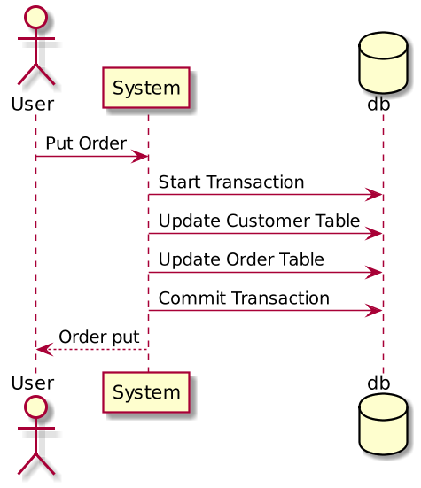
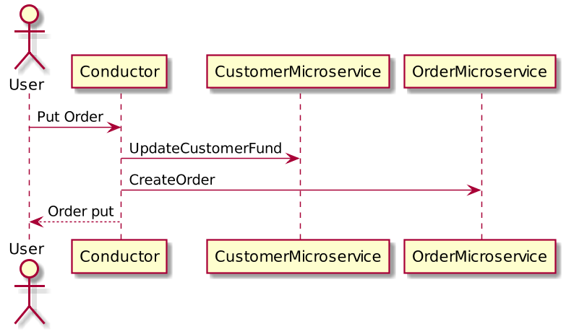
Where should we use Microservice
Do you heavily rely on transactions?
monolithic system
microservices system
To implement transaction in a microservice system is very hard comparing to a monolithic system.
Notes:
Another big problem is transaction.
If your business logic is heavily rely on transactions, you may not use microservice here.
To implement transaction in a microservice system is very hard comparing to a monolithic system.

Slide 11
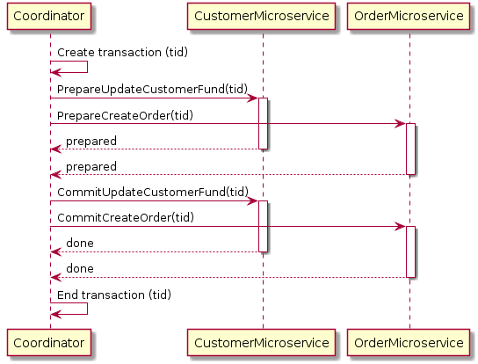
Where should we use Microservice
Two-phase commit (2pc) pattern
Usually, people use a technique called two-phase commit to simulate transaction in microservice architecture. It has a prepare phase and commit phase to ensure the the eventual consistency. It will be more complicated if there is some error and cause a rollback. So If you don’t want to deal with the two phase commit in distributed transaction, you shouldn’t use microservice here. But other parts can still be splited into different microservices.
Notes:
Usually, people use a technique called two-phase commit to simulate transaction in microservice architecture. It has a prepare phase and commit phase to ensure the the eventual consistency. It will be more complicated if there is some error and cause a rollback. So If you don’t want to deal with the two phase commit in distributed transaction, you shouldn’t use microservice here. But other parts can still be splited into different microservices.

Slide 12
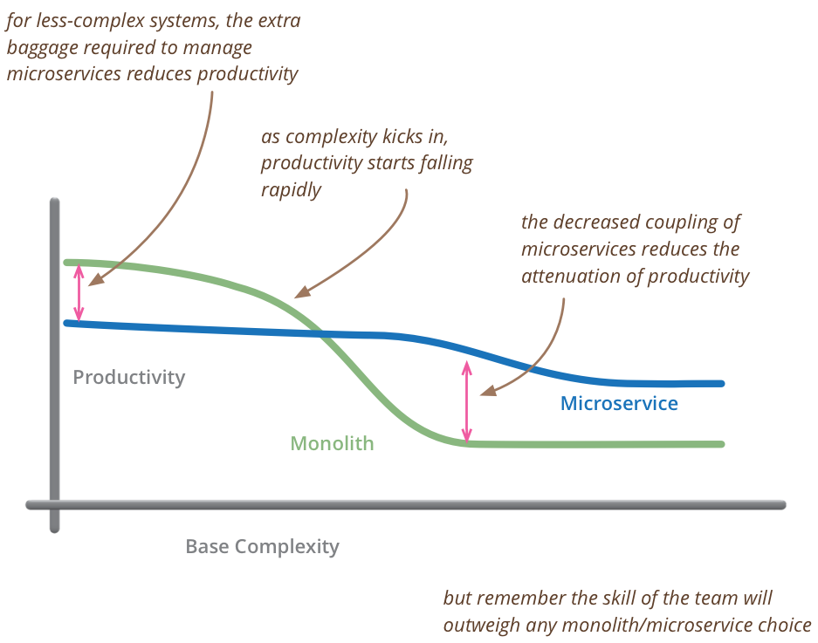
When should we use Microservice
Notes:
Here comes the question about when should we use Microservice.
Comparing to the monolithic architecture, the microservice architecture have lower productivity at first. That’s because microservice need a certain amount of management so it can’t start with relatively high productivity.
while monolithic system not quite need those management at the beginning since the system is simple enough so writing it is as simple as writing a simple microservice
When the complexity of the system growth and hit some threshold, the productivity of monolithic system and microservice system will become the same.
After that, because of the decreased coupling of microservices reduces the attenuation of productivity, but the monolithic system’s productivity will drop rapidly when complexity growth. It’s the time to switch to microservice architecture.

Slide 13
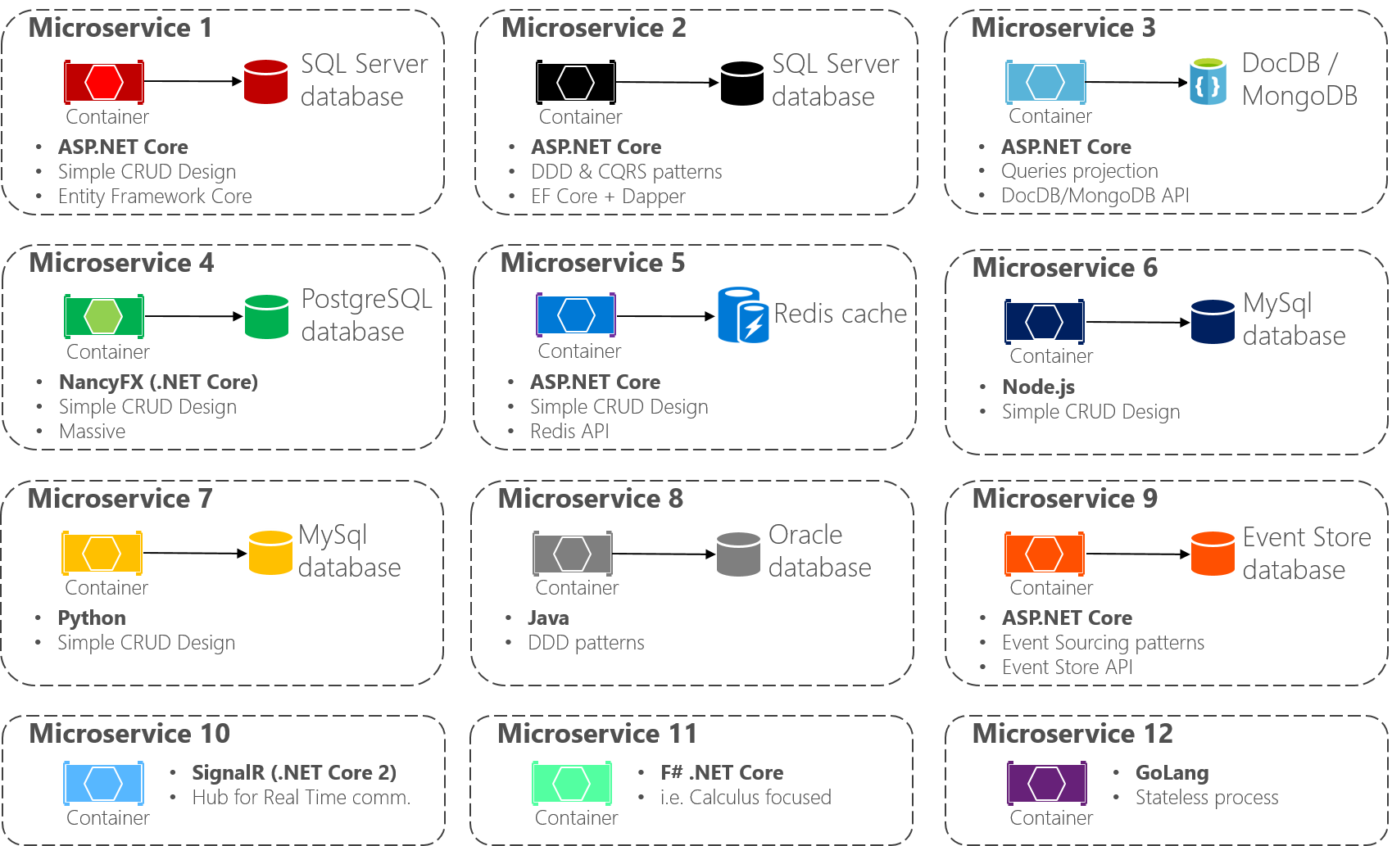
How to use Microservice
Programming language doesn’t matter
You can use any programming language you want as long as you can provide solid API documentation so other services can communicate with it and invoke the service properly.
Notes:
In microservice architecture, programming language usually doesn’t matter. You can use any programming language you want as long as you can provide solid API documentation so other services can communicate with it and invoke the service properly. Here is a microservice architecture example given by microsoft. you can see it uses many different languages like C#, JS, Python, Java,signalR,F#, and golang.

Slide 14
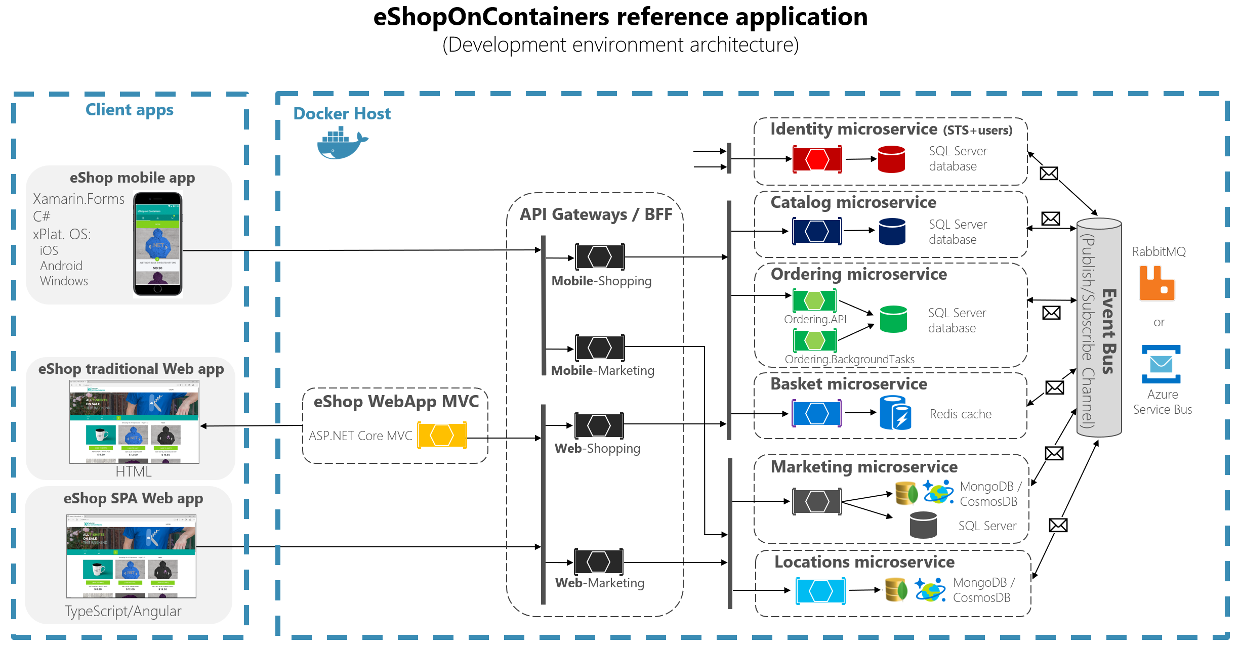
How to use Microservice
In this architecture, Microsoft uses rabbitMQ and AzureService Bus as the eventbus middleware for data/message sharing between all the microservices.
Using message queue can change the business logic from synchronized logic to asynchronized logic and result in a better io performance.
Notes:
Here is a overview of an eshop application using microservice architecture also provided by microsoft. you can pause at here and spend some time looking at the diagram and learn this architecture.
Notice that in this architecture, microsoft uses rabbitMQ and AzureService Bus as the eventbus middleware for data/message sharing between all the microservices.
Using message queue can change the business logic from synchronized logic to asynchronized logic and result in a better io performance.

Slide 15
Discussion
Positive
Very strong scalability
Distribution
Non-uniform Scaling
Portability
Elasticity
Availability
Robustness
Programming language doesn’t matter, easy to find a developer to build microservices
For a complex system, microservice architecture has higher productivity
Easy to learn, even intern developers can also develop functional and bugless microservice with proper unit test.
Agile friendly
Notes:
so here is the discussion part. I think microservice architecture has these following advantages:
As mentioned before, it has very strong scalability, and the developers can choose whatever language they prefer to build microservices.
For a complex system, microservice architecture usually has higher productivity.
And writing a microservice is very easy. I think even intern developers can also develop functional and bugless microservice with proper unit test.
Also, microservice architecture is agile-friendly. it’s very common to use one or two sprint to develop, evaluate, and improve a microservice.

Slide 16
Discussion
Negative
The granularity of a microservice architecture is hard to decide
Microservice need more precise documentation
Microservice need more experienced System Operator
Microservice should be integrated with Continuous Integration (CI) and Continuous Delivery (CD) otherwise it will cost too much human resource in maintenance
Notes:
But also microservice architecture has some disadvantages and we need to treat these problems carefully.
The biggest problem is the granularity of a microservice architecture is hard to decide.
If the granularity is too low, it can not take advantage of the scalability of microservice because it will looks more like a monolithic system.
but if the granularity is too high, there will be too many message exchanges happen in the eventbus and cause a large latency. The dependencies will also become much more complex and make it harder to manage.
Besides, microservice architecture needs more precise and solid documentation otherwise the invoke chain will be unclear and the whole system may be out of control when its complexity grow.
Because of the management is harder than a monolithic system, microservice architecture needs more experienced system operator.
And the microservice should be integrated with continuous integration and continuous delivery to do a lot of jobs automatically otherwise it will cost too much human resource in maintenance.

Slide 17
Discussion
NO SILVER BULLET
Notes:
In the end, I want to say that there is no silver bullet in software engineering. we can never find an architecture which can meet all the requirement without any weak points and extra cost.
Understanding microservice architecture is just giving you another choice when you are designing a software architecture.

Slide 18
Reference
Dragoni, N., Lanese, I., Larsen, S. T., Mazzara, M., Mustafin, R., & Safina, L. (2017, June). Microservices: How to make your application scale. In International Andrei Ershov Memorial Conference on Perspectives of System Informatics (pp. 95-104). Springer, Cham.
Hasselbring, W., & Steinacker, G. (2017, April). Microservice architectures for scalability, agility and reliability in e-commerce. In 2017 IEEE International Conference on Software Architecture Workshops (ICSAW) (pp. 243-246). IEEE.
Anderson, C. (2015). Docker [software engineering]. IEEE Software, 32(3), 102-c3.
Dragoni, N., Giallorenzo, S., Lafuente, A. L., Mazzara, M., Montesi, F., Mustafin, R., & Safina, L. (2017). Microservices: yesterday, today, and tomorrow. In Present and ulterior software engineering (pp. 195-216). Springer, Cham.

Slide 19
Thank you!
If you have any questions about microservice,
please feel free to send me email.

